Slide 1
Project 2: Optimizing Home CareService Routing Using a Genetic Algorithm
Tanguy guyot

Slide 2
Chromosome representation
Each individual as a list of lists
Route for nurse 3
[ [21, 24, 25, 27, 20], [90, 87, 91], [75], … , [57,58, 60, 59] ]
Route for nurse 1
Route for nurse 2
Route for nurse 25

Slide 3
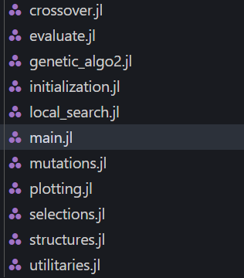
Algorithm structure
Population creation
Tournament selection
Random solution
Injection
(if 5 generations with
same best solution)
Crossover
Mutations
Survivor selection
(every 5 generations)
Local search
New generation
Best solution output and plots

Slide 4
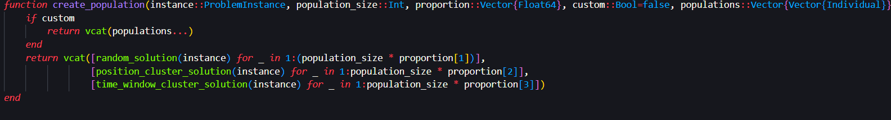
Population creation
- Either creates a population mixing clustered patients in position, clustered patients in time window and random solution ; proportioned with a list for example like this :
[0.3 (random solutions), 0.7 (position cluster), 0 (time window cluster)]
- Or define a custom population (used for island niching)

Slide 5
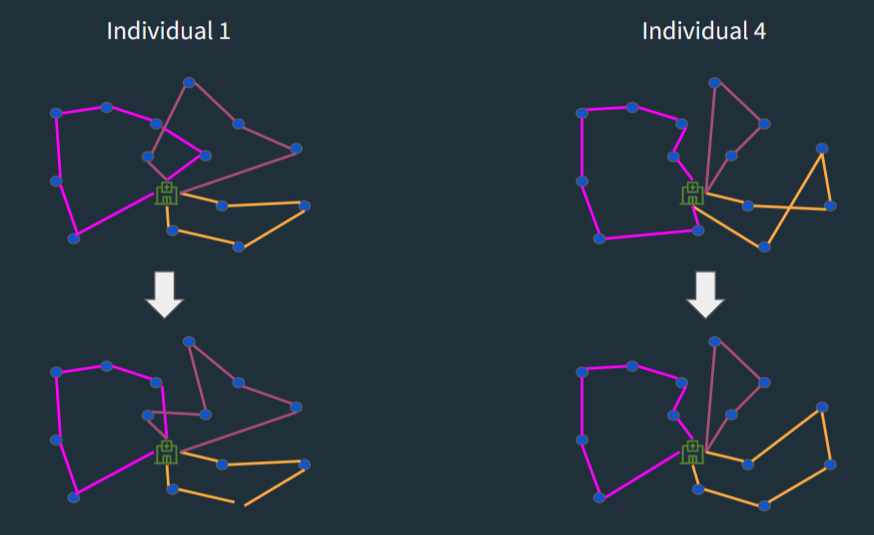
Crossover
Crossover method suggested by Visma kick-off slides in the appendix
Select two random nurses and copy them into childs
Select two routes (list of integers) from each child
Remove the patients corresponding to one route to the other child
Reinsert the missing patients of each child by finding the best insertion (using evaluation function)
It is computationally long to find the best insertion like this, but it works well
From Visma slides (Project Kick-off)

Slide 6
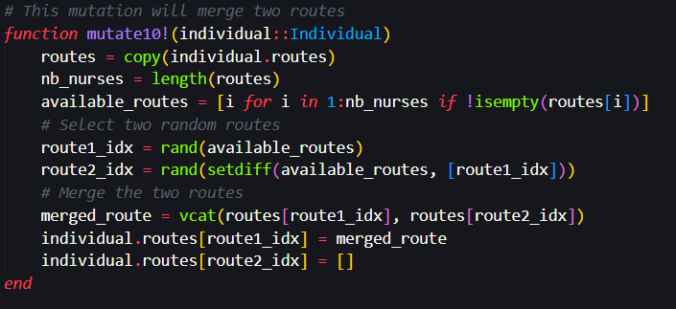
Mutations
5 kind of mutations used :
- Swaps two patients of two routes
- Shuffles a subset of patients of a route
- Movess a patient in an other route
- Splits a route in half
- Merges two routes (concatenation)

Slide 7
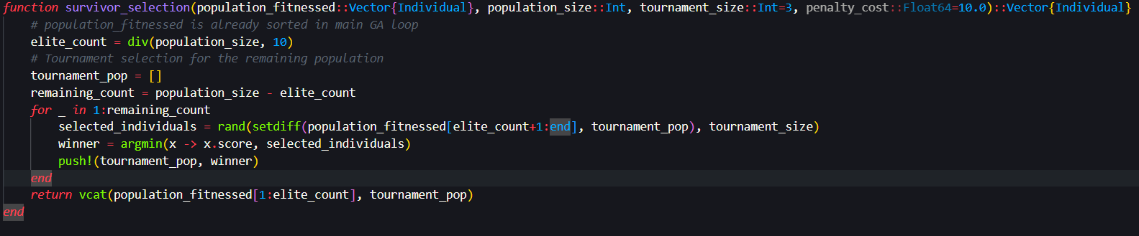
Selections
- Parent selection : simple tournament selection between 3 random individuals
- Survivor selection : Keep the 30% best individuals, add the 70% remaining using tournament selection between 3 individuals

Slide 8
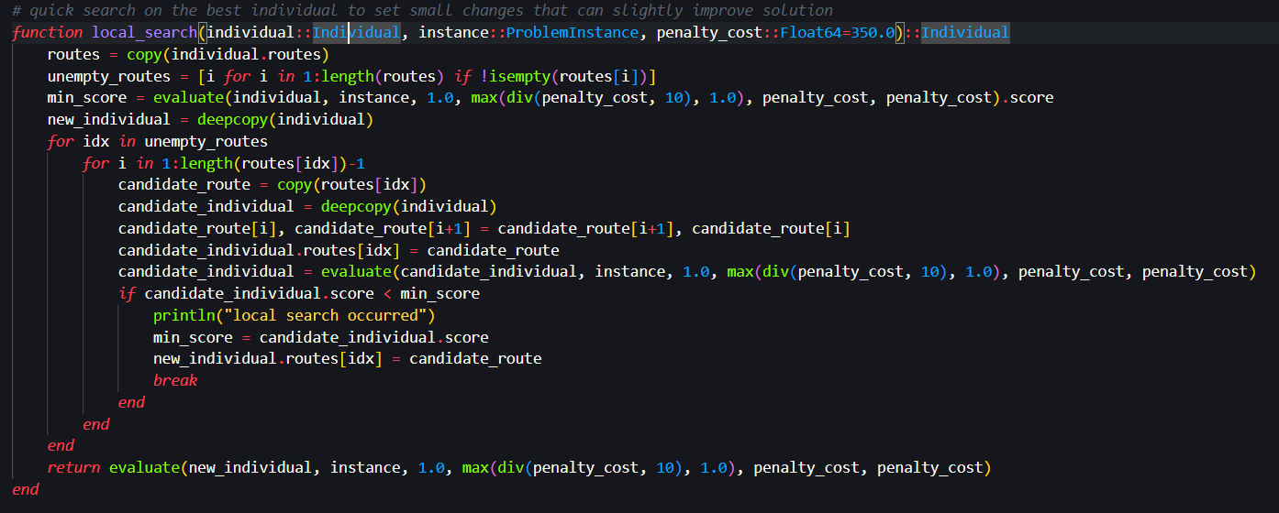
Local search
Small local search implemented at the end of every 5 generations on the best individual

Slide 9
Adding new population

Slide 10
Multithreading

Slide 11
Island niching

Slide 12
Adaptive penalty cost

Slide 13
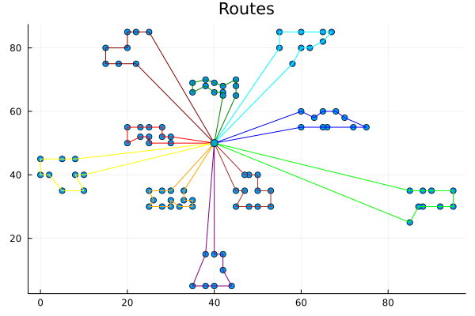
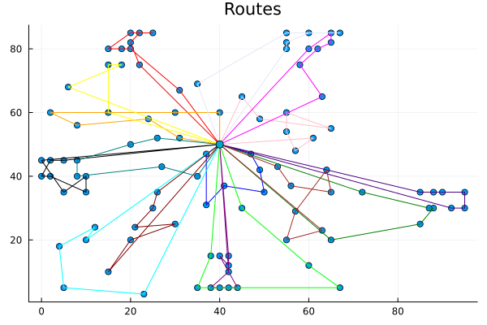
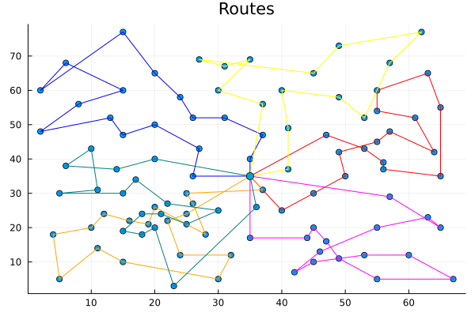
Results
Test 0 :
Nurse capacity : 200
Depot return time : 1236
Objective value (total duration): 828.9368669428338 ( < 5% benchmark)
Test 1 :
Nurse capacity : 200
Depot return time : 240
Objective value (total duration): 1659.1448976431811 (< 10% benchmark)
Test 2 :
Nurse capacity : 200
Depot return time : 1236
Objective value (total duration): 53.4100789339775 (< 10% benchmark)

Slide 14
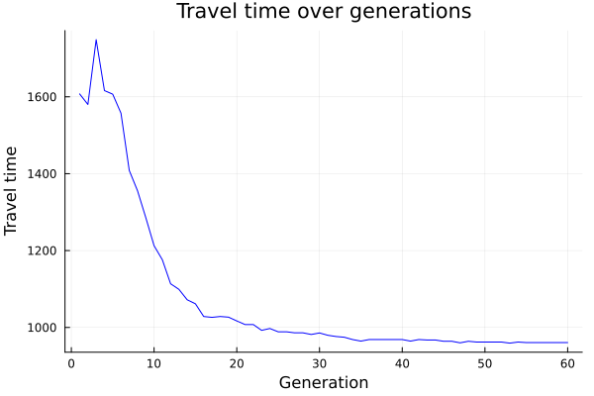
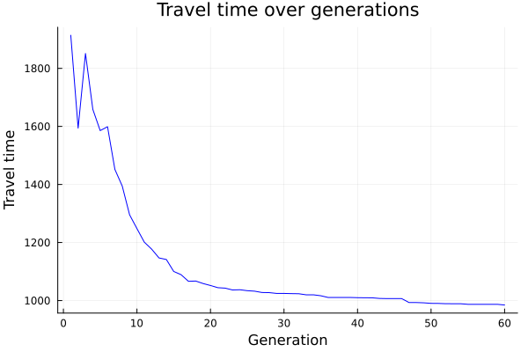
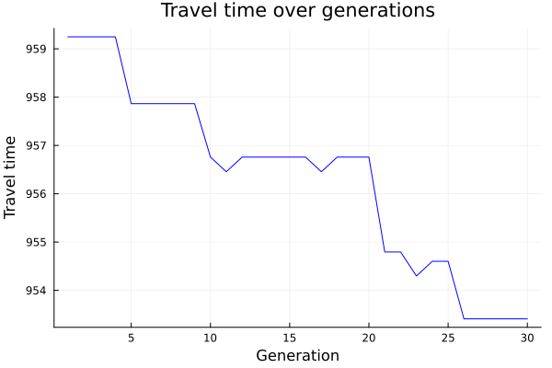
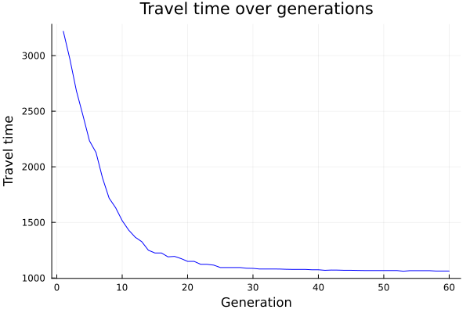
Results: example of travel times evolution over generations
Travel time evolution of each algorithm for test2 :
New GA on the three merged populations
[0.3, 0.7, 0]
[0.7, 0.3, 0]
[0, 0, 1]

Slide 15
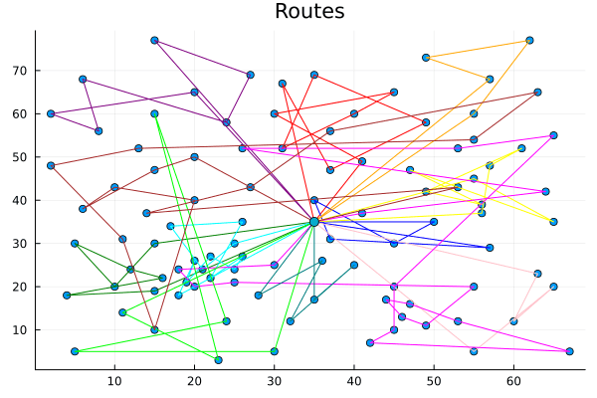
Results : evolution of a route example
Example from test2 solution with [0.3, 0.7, 0] initialization proportion

Slide 16
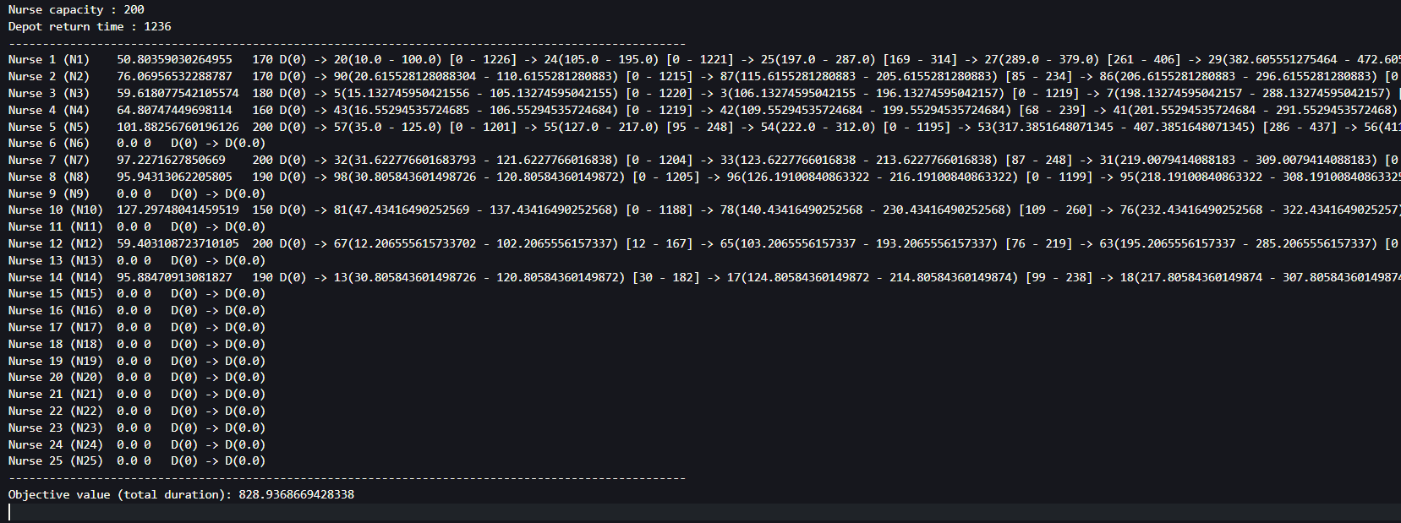
Results : output file example
Output file for test0 (available in .zip file)

